Slide 1
ML-RECOG
D PetaBytes

Slide 2
What is ml-reCog?
SaaS product which does liveness detection and reverse image search
APPLICABILITY TO FINTECH
Platform Agnostic
USP
Credible and scalable platform
COST EFFICIENCY
Machine learning based

Slide 3
Potential Business Opportunities
Merchant Onboarding
Financial Instruments - MFs, BNPL
Customer Onboarding
Fraud prevention

Slide 4
Use Case - Merchant Onboarding
Fraud and bogus merchant onboardings
~ 18% / 5400 merchants shops non-traceable
MCA loans to 5400 merchants @40K ~20Cr
Freecharge doing ~1500 video KYC in a day
Approximate cost of this verification is 3 Lacs/month

Slide 5





I need business growth…
Think freecharge

Slide 6


Let me help you Get onboarded with freecharge...
Fill name, pan and aadhaar details
D PETA BYTES
CCBP25992G
3499 0836 2186

Slide 7


D PETA BYTES
Please enable camera and upload a short video
CCBP25992G
Liveness check passed !!
Now please upload image of your shop
3499 0836 2186

Slide 8
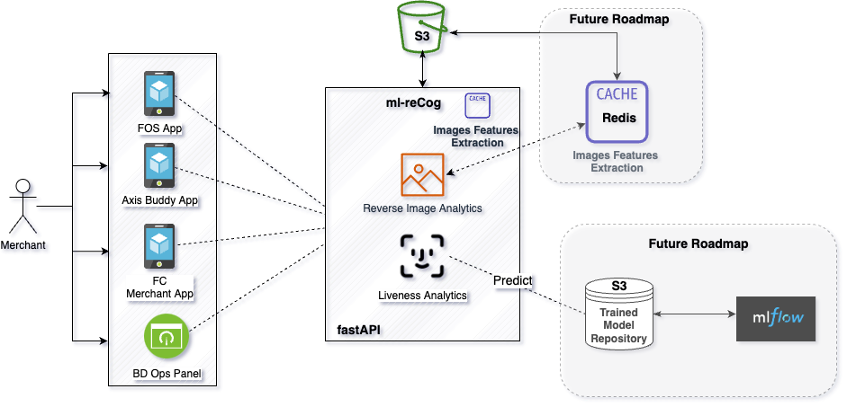
ARCHITECTURE DIAGRAM

Slide 9



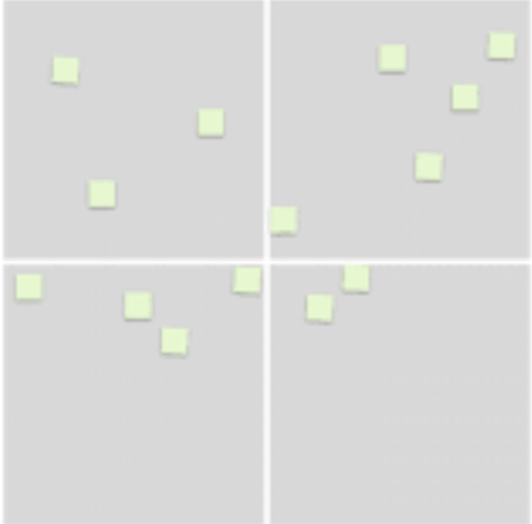
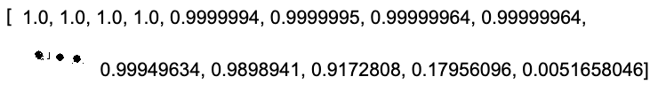

TRAINING & PREDICTION
Front facial image dataset (1M images) Convolutional Neural Network designed and trained on 800k images
Tested on 200k images
Captured 24 frames per sec from the video and evaluate each frames on the model that generates a 95 percentile confidence on total frames
VGG16 is a pretrained CNN model with 16 layers trained on imagenet dataset with ~1M images
It resizes each image into 264 x 264 px and extracts their features.
Those features are matched with existing cached features and distance is normalized.
Based on a configurable threshold, it decides whether we have a similar image already present in our dataset or not.
[0.9627]
95%ile

Slide 10
LIBRARIES & LICENSES
GNU General Public License version 2.0
Numpy
Keras - Apache License
Cmake -
Face_recognition - MIT License
Opencv-python - MIT License
Fastapi - MIT
Uvicorn - BSD clause-3
Python-multipart - Apache Software
Matplotlib
Pandas

Slide 11
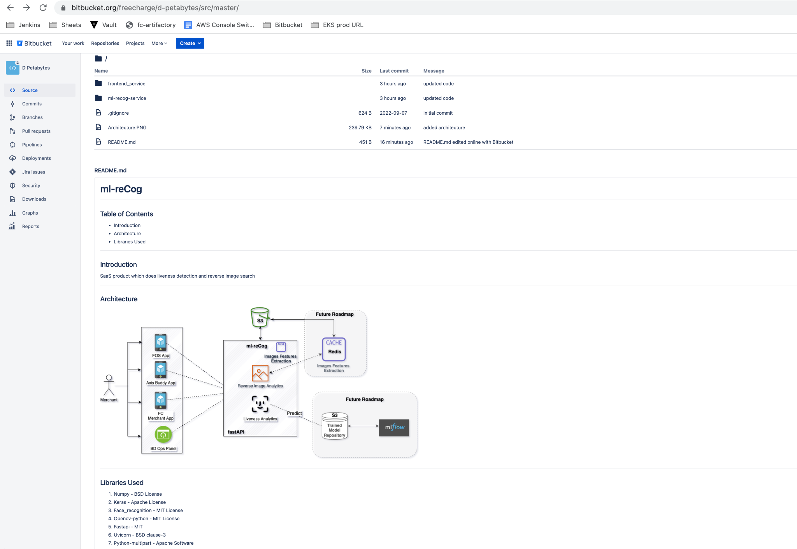
CODE READINESS
Repository Insights
Compilable code
Fully integrated with frontend
Architecture diagram
Documentation
Functions with comments
Dependencies in requirements.txt

Slide 12
Thank You
Q&A

